Slide 1

Communication Theory I ET 2213
Major Chanaka Ranasinghe SLSC

Slide 2
The modules to be covered
1. Amplitude Modulation (10 hrs)
Introduction to Communication, AM modulation and its limitations, AM Receiver, DSB-SC Modulation, SSB-SC Modulation, Vestigial Sideband modulation, Baseband representation of modulated waves and band pass filter
2. Angle Modulation (9 hrs)
Properties of Angle Modulated Signal, Relationship between PM and FM, Narrow Band FM, Wideband FM, Transmission , Generation and Demodulation of FM waves
3. Pulse Modulation (9 hrs)
Sampling Process, PAM, PPM, Quantization, PCM, Delta Modulation, Differential PCM, Line codes
4. Random Signals and Noises (6 hrs)
Probability and random variables, Expectation, Gaussian Random Variables,
The central limit theorem, Random processes, Correlation of Random Processes, spectra of Random Signals, Gaussian Processes, White Noise, Narrow Band Noise
5. Noise in Analog Communication (10hrs)
Noise in communication systems, Signal to Noise Ratio, Band pass receiver structures, Noise in Linear receivers using Coherent detection, Noise in AM Receivers using envelop detection, Noise in SSB Receivers, Detection of Frequency Modulation(FM), FM pre-emphasis and De-Emphasis

Slide 3
Method of Assessment
Continuous Assessment : 30%
End Semester Examination : 70%

Slide 4
Important Points
Total Credits : 3
Total Number of Hours : 45
Number of hrs to cover the Modules : 42
Continues Assessments/Tutorials/Practicals: 6 hrs

Slide 5
References
Bruce Carlson and Paul Crilly,(2009).Communication Systems, McGraw-Hill Education.
Simon Haykin, Michael Moher. Communication Systems

Slide 6
What is communication?
Communication is the mechanism of sending, processing and receiving data or information by electrical means (In Engineering point of view).

Slide 7
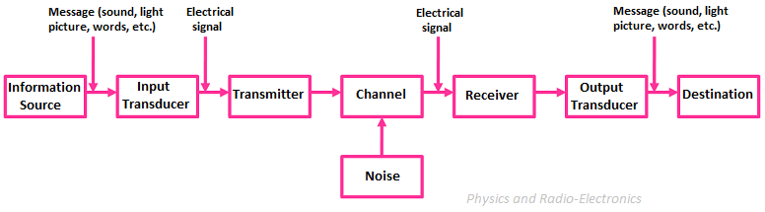
Block Diagram of Communication system

Slide 8
Input Transducer
Information Source
It generates the data message to be transferred. The message can be audio, Video, image Signal. For Ex- Human Voice in an audio signal.
The input transducer converts the non-electrical signal into electrical form. Ex- microphone converts human voice into an Electrical Voltage or Current signal.

Slide 9
Transmitter
Transmitter is a combination of modulator, amplifier and antenna. The modulator-amplifier strengths or enhances signal characteristics such as amplitude, frequency and phase for long distance transmission. The antenna converts electrical signals into electromagnetic waves(in Wireless communication).

Slide 10
Channel
The Channel is the medium of propagation of the electrical data/massage signal. It is a transmission medium. Ex, air, copper cables, Co-axial cables, optical fiber cables.
Basically a combination of Antenna, Demodulator , Amp. The Demodulator extracts the original message signal from the modulated carrier.
Receiver

Slide 11
Output Transducer
The Output transducer convers electrical signal into original non-electrical form. Ex- Loudspeaker convers electrical signal into voice signal.

Slide 12
Module 1: Amplitude Modulation

Slide 13
What is Modulation?
Modulation is the process of changing the parameters of the carrier signal, in accordance with the instantaneous values of the modulating signal.

Slide 14
Need for Modulation
Baseband signals are incompatible for direct transmission (there are some possible uses are exists)
For such a signal, to travel longer distances, its strength has to be increased by modulating with a high frequency carrier wave, which doesn’t affect the parameters of the modulating signal
A high frequency signal can travel up to a longer distance, without getting affected by external disturbances , We take the help of such high frequency signal which is called as a carrier signal to transmit our message signal

Slide 15
Advantages of Modulation
Reduction of antenna size
No signal mixing
Increased communication range
Multiplexing of signals
Possibility of bandwidth adjustments
Improved reception quality
The antenna used for transmission, had to be very large, if modulation was not introduced. The range of communication gets limited as the wave cannot travel to a considerable distance without getting distorted.

Slide 16
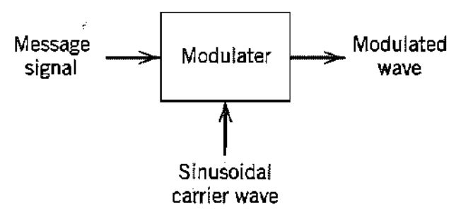
Signals in the Modulation Process
Following are the three types of signals in the modulation process

Slide 17
Message or Modulating Signal The signal which contains a message to be transmitted, is called as a message signal. It is a baseband signal, which has to undergo the process of modulation, to get transmitted. Hence, it is also called as the modulating signal.
Carrier Signal The high frequency signal, which has a certain amplitude, frequency and phase but contains no information is called as a carrier signal. It is an empty signal and is used to carry the signal to the receiver after modulation.
Modulated Signal The resultant signal after the process of modulation is called as a modulated signal. This signal is a combination of modulating signal and carrier signal.

Slide 18
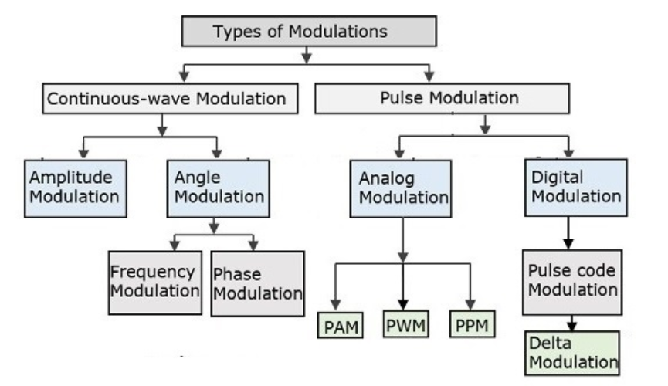
Types of Modulation
In continuous-wave modulation, a high frequency sinusoidal wave is used as a carrier wave. This is further divided into amplitude and angle modulation.
In Pulse modulation, a periodic sequence of rectangular pulses, is used as a carrier wave. This is further divided into analog and digital modulation.

Slide 19
AMPLITUDE MODULATION – AM (DSB -FC)

Slide 20
AMPLITUDE MODULATION – Definition
The amplitude of the carrier signal varies in accordance with the instantaneous amplitude of the modulating signal.

Slide 21
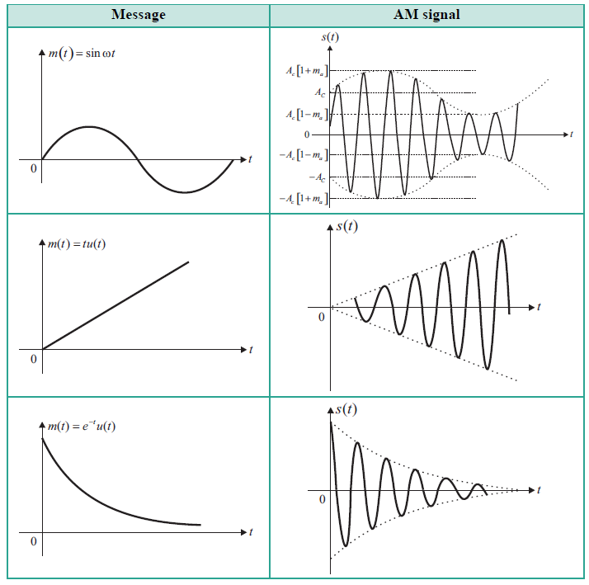
In AM, the peak amplitude c(t)=Accos(2πfct) of the carrier is varied linearly with the amplitude of the message signal.

Slide 22
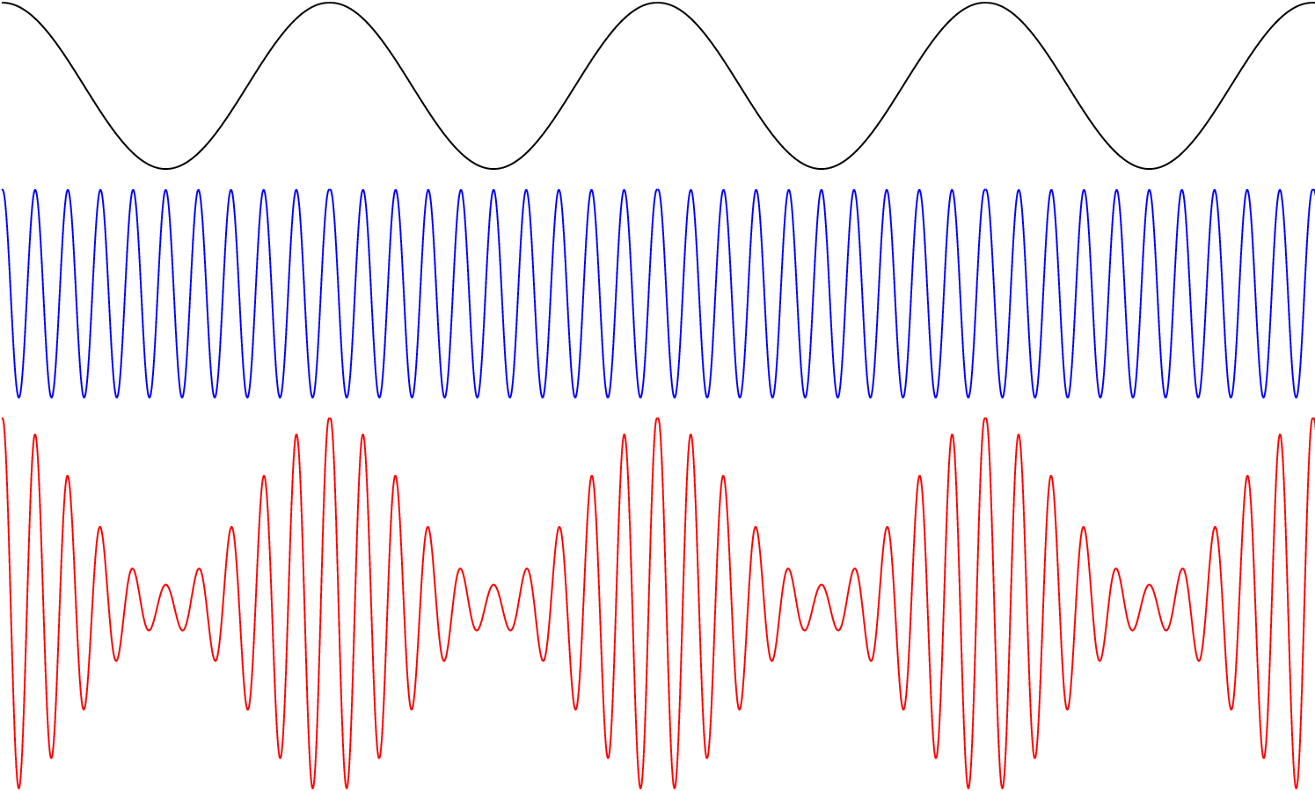

Slide 23
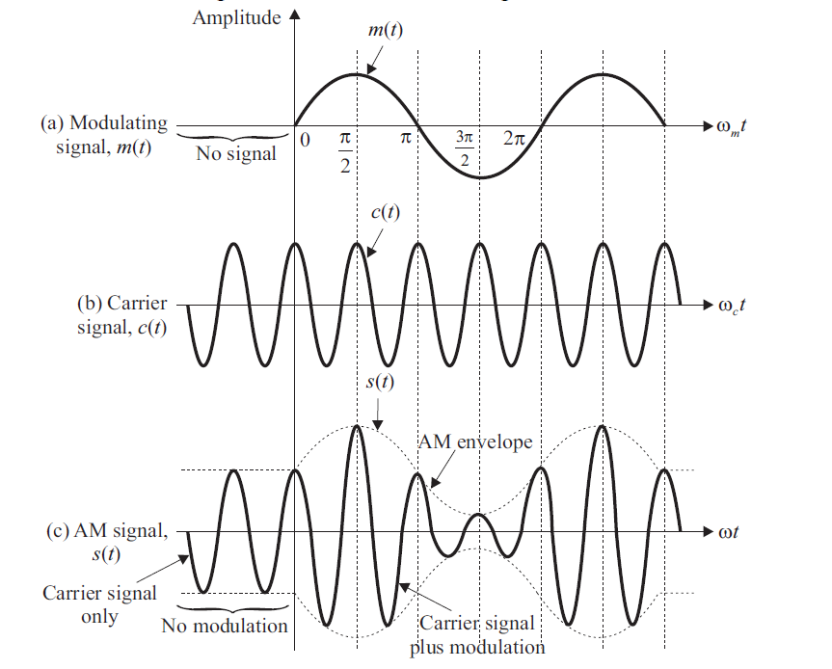
From the amplitude-modulated signal waveform, it is observed that:
When no modulating signal is applied, the modulated AM signal waveform is simply the unmodulated carrier signal C(t).
When a modulating signal - m(t) is applied, the amplitude of modulated signal waveform varies in accordance with the amplitude of the modulating signal.
The frequency of the carrier signal in the amplitude modulated signal waveform remains the same as that of the original unmodulated carrier signal.

Slide 24
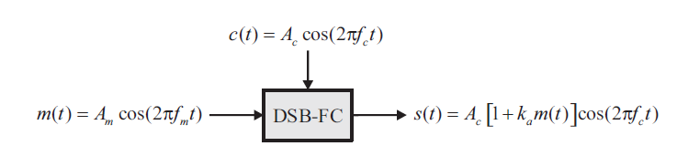
Figure illustrates the relationship among the modulating signal m(t) , the carrier signal c(t) ,
and the amplitude modulated signal s(t) for amplitude modulated (AM) signal, will be described later.

Slide 25
Mathematical Expressions
Time-domain Representation of the Waves
For a single-tone modulating signal, the modulating signal be, m(t)=Amcos(2πfmt)
and the carrier signal be, c(t)=Accos(2πfct) – we have assumed that the phase is equal to zero when t=0
Where,
Am and Ac are the Amplitude of the Modulating Signal and the Carrier Signal respectively.(Typically measured in volts- v)
fm and fc are the frequency of the modulating signal and the carrier signal respectively.(fc >> fm)

Slide 26
Then, the Time domain equation of standard Amplitude Modulated wave can be written as;
S(t)=Ac[1+Kam(t)]cos(2πfct) : Where Ka is the amplitude Sensitivity
We can get : S(t)=[Ac+m(t)]cos(2πfct)
S(t)=[Ac+Amcos(2πfmt)]cos(2πfct)
We can see that:
S(t)=Accos(2πfct) +m(t)cos(2πfmt)
(Carrier Wave + Side Bands)

Slide 27
Mathematical Expressions
Amplitude Sensitivity of the Modulator
S(t)=[Ac+m(t)]cos(2πfct)
S(t)=Ac[1+(1/Ac)m(t)]cos(2πfct)
S(t)=Ac[1+Kam(t)]cos(2πfct)
Ka is a constant and is called Amplitude Sensitivity of the Modulator.
If the message signal is a voltage signal : Ka is Measured in (1/Vots)
Responsible for generating of the modulated Signal.
Use the Equation Ka=1/Ac , [Use, if Ka is not given at the question]

Slide 28
Envelop of the modulated Wave
The time-varying shape of the amplitude-modulated waveform is called the envelope of the AM signal or simply the AM envelope.
From amplitude-modulated waveform as shown in above figure, the following is observed :
When the peaks of the individual waveforms of the carrier signal in amplitude-modulated wave in positive half and negative half are joined together separately (as shown by dotted lines), the resulting envelopes resemble the original modulating signal.
The exterior shape of the each half (positive or negative) of the AM envelope is identical to the shape of the modulating signal.

Slide 29
The modulated AM wave contains the information signal in the amplitude variations of the carrier signal.
The AM envelope contains all the frequency components (the carrier signal, sum and difference of carrier frequency and modulating frequency) that make up the AM signal.
E(t) = Ac(1 + kam(t)) is called the Envelope of the AM signal.
This is very much important, because at the receiver, we need to recover the massage signal from the Modulated wave.

Slide 30
Modulation Index- (Depth of Modulation)
A carrier wave, after being modulated, if the modulated level is calculated, then such an attempt is called as Modulation Index or Modulation Depth. It states the level of modulation that a carrier wave undergoes.
The amplitude modulation index is also known as depth of modulation, coefficient of modulation, degree of modulation, modulation factor.
Generally Modulation index is defined as :
μ = Ka.Max [m(t)]=KaAm
Where as: μ = Am/Ac : [Use if, Ka is not given at the question]

Slide 31
We know that:
S(t)=Ac[1+Kam(t)]cos(2πfct)
⇒S(t)=Ac[1+μcos(2πfmt)]cos(2πfct)
we can write the modulation index as: μ=Am/Ac
Let Emax and Emin be the Maximum and Minimum amplitudes of the modulated wave and these values are the maximum and Minimum values of the Envelope.{E= Ac[1+μcos(2πfmt)]}
We will get the The maximum value of the positive envelope when cos(2πfmt) is 1:
⇒Emax= Ac .[1+μ] = Ac+Am

Slide 32
We will get the The minimum value of the positive envelope, when cos(2πfmt) is -1.
⇒Emin= Ac .[1-μ] = Ac−Am
We can get ; Emax + Emin =Ac + Am + Ac− Am=2Ac
⇒Ac=(Emax + Emin)/2
We can get ; Emax−Emin=Ac + Am−(Ac−Am)=2Am
⇒Am=(Emax−Emin)/2
Am/Ac=(Emax−Emin)/2/(Emax +Emin)/2
μ=(Emax −Emin)/(Emax + Emin): Another equation for the Modulation Index

Slide 33
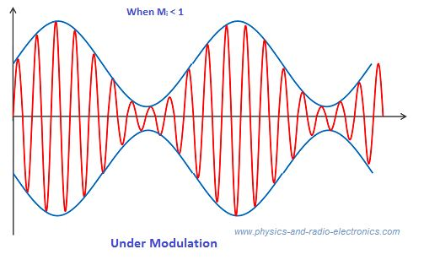
Based on Modulation Index, there are three types of modulation
Under Modulation : (μ<1)
Occurs when the maximum amplitude of the message signal or modulating signal is less than the maximum amplitude of the carrier signal (A_{m} < A_{c}).
Under-modulation causes no distortion

Slide 34
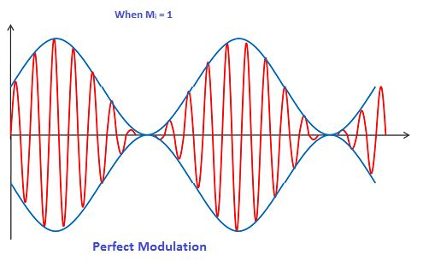
Perfect modulation (μ=1)
Occurs when the maximum amplitude of the message signal or modulating signal is exactly equal to the maximum amplitude of the carrier signal (Am = Ac).
Perfect-modulation causes no distortion

Slide 35
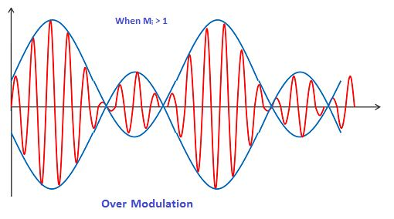
Over Modulation (μ>1)
Occurs when the maximum amplitude of the message signal or modulating signal is greater than the maximum amplitude of the carrier signal (A_{m} > A_{c}).
causes severe distortion of the waveform of the message signal which results in data loss
In over-modulation, the carrier wave experiences 180° phase reversals where, the carrier level falls below the zero point.

Slide 36
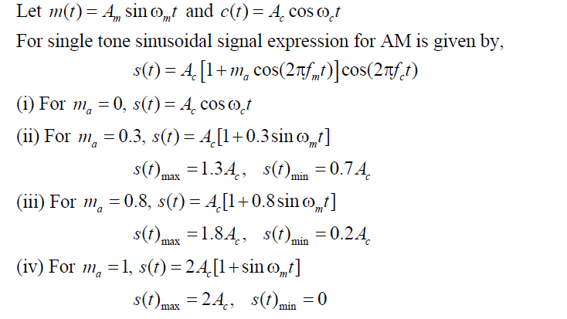

Effect of Modulation Index on AM Envelope

Slide 37
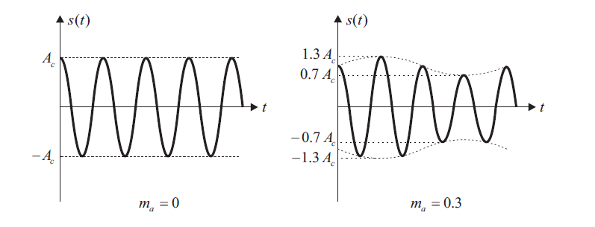
Effect of Modulation Index on AM Envelope

Slide 38
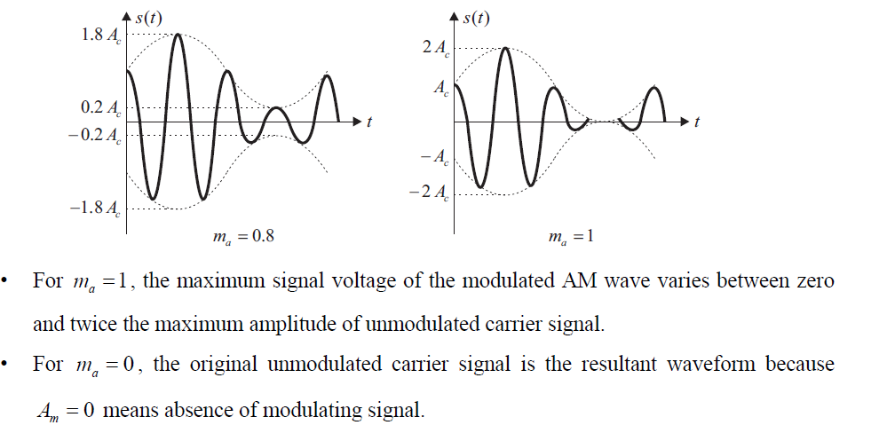
Effect of Modulation Index on AM Envelope

Slide 39
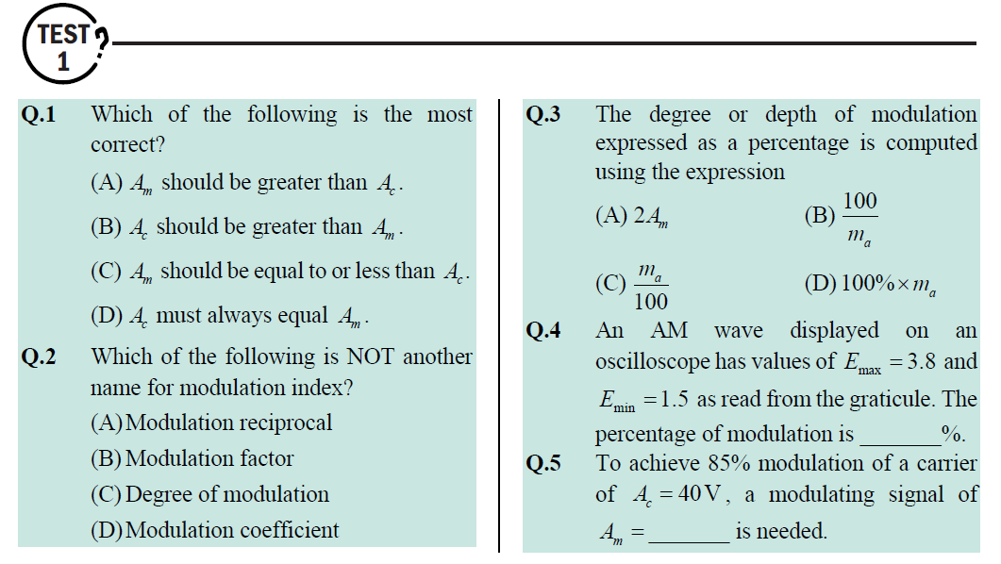

Slide 40
Trapezoidal Pattern
Definition : Trapezoidal pattern is a display on a standard oscilloscope used for measurement of the modulation characteristics (modulation index, percent modulation, coefficient of modulation, and modulation symmetry) of amplitude-modulated waveform.

Slide 41
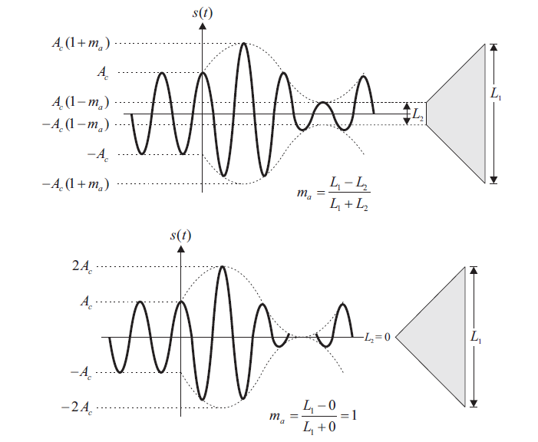
Trapezoidal Pattern

Slide 42
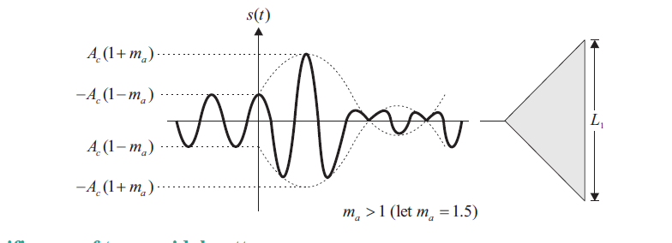
Trapezoidal Pattern
Trapezoidal pattern is quite useful when the modulating signal is a non-periodic signal such as speech waveform which contains complex sinusoidal waveforms
AM transmitter modulation characteristics such as modulation symmetry and modulation index can be easily and accurately interpreted by observing trapezoidal patterns of the modulated signal on the standard oscilloscope display

Slide 43
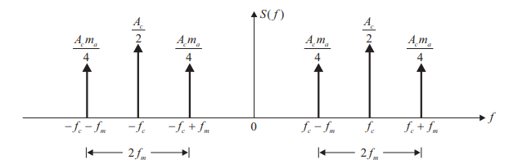
Frequency Domain Representation of AM wave
We Can write S(t) As: S(t)=Ac[1+μcos(2πfmt)]cos(2πfct)
⇒S(t)=Accos(2πfct)+Acμcos(2πfct)cos(2πfmt)
⇒S(t)=Accos(2πfct)+(1/2)Acμcos[2π(fc+fm)t]+Acμ(1/2)cos[2π(fc−fm)t]
We need to take Furrier Transformation :
Accos(2πfct) FT (Ac/2)[(f-fc) + (f+fc)]
; Do the same for each components

Slide 44
Bandwidth of AM Wave
Bandwidth (BW) is the difference between the highest and lowest frequencies of the signal. Mathematically, we can write it as
BW = fmax−fmin
Hence, the amplitude modulated wave has three frequencies. Those are carrier frequency- fc, upper sideband frequency fc+fm and lower sideband frequency fc−fm
Here,
fmax=fc+fm and fmin=fc−fm

Slide 45
Substitute, fmax and fmin values in bandwidth formula.
BW=fc+fm−(fc−fm)
⇒BW=2fm
Thus, it can be said that the bandwidth required for amplitude modulated wave is twice the maximum frequency of the modulating signal.
Q-1 :Bandwidth of AM wave is 20KHz, and highest frequency present is 800 KHz. Find out the carrier frequency used?
Q-2 : Consider the AM Signal S(t) = [1+m(t)]cos(2πfct),It is given that the BW of real Law Pass Massage Signal is 2 KHz. Find the BW of AM wave?

Slide 46
Power Calculations of AM Wave
Consider the following equation of amplitude modulated wave (Single Tone).
S(t)=Ac[1+μcos(2πfmt)]cos(2πfct) or S(t)=Ac[1+Kam(t)]cos(2πfct)
S(t)=Accos(2πfct)+(1/2)Acμcos[2π(fc+fm)t]+(1/2)Acμcos[2π(fc−fm)t]
Power of AM wave is equal to the sum of powers of carrier, upper sideband, and lower sideband frequency components.
Pt=Pc+PUSB+PLSB

Slide 47
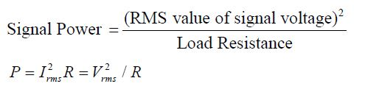
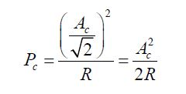
In general, the power of a signal is given as the ratio of square of RMS value of signal voltage and the load resistance. We know that the standard formula for power is:
Where,
vrms is the RMS [Root Mean Square] value of cos signal.
First, let us find the powers of the carrier, the upper and lower sideband one by one.
The peak amplitude of the carrier term in AM signal is the same as that of un modulated carrier signal. Therefore, the carrier power is given as:
Carrier power
If the value of R is not given, assume as R = 1

Slide 48
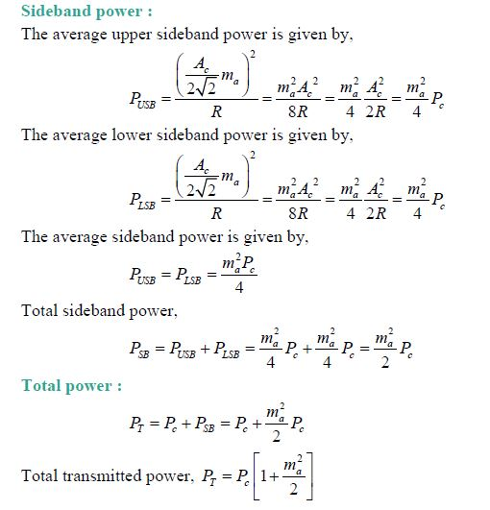

Slide 49
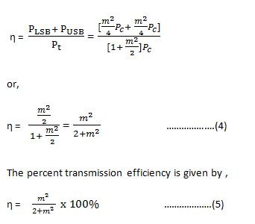
Transmission efficiency of AM Wave
Transmission efficiency = Total Side Band Power
Total Transmitted Power

Slide 50
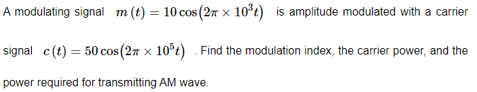
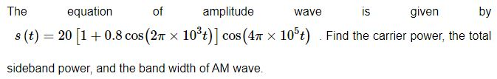
Q-1: For an Amplitude Modulated Signal, Which carrier power is 500W ,and the Modulation index is 0.75, Calculate the total power ,and Power of each side Bands?
Q-2 : Due to an AM, by a sinusoidal wave , if the total current in the Antenna increases from 4 A to 4.8 A, Find the Depth of the modulation in percentage? (Assignment 1-Qu 1)
Q-3 :
And Find out the Transmission Efficiency?
Q-4 :
Notes:
Q-1 :640.5W
Q-2: 0.938
Q-3 : Pc -1250W
Pt = 1275 W

Slide 51
Exam Questions (Intake 36) Class Room
A Sinusoidal carrier frequency of 1.2MHz is amplitude modulated by a sinusoidal voltage of frequency 20KHz , resulting in maximum and minimum modulated carrier amplitude of 110V & 90V respectively. Find out followings:
i. Frequency of lower and upper side bands
ii. Un-modulated carrier amplitude
iii. Modulation index
iv. Maximum Amplitude of each side bands
Notes:
Q-1 :640.5W
Q-2: 0.938
Q-3 : Pc -1250W
Pt = 1275 W

Slide 52
Exam Questions (Intake 37) :Home Work
A 350W, 1.2 MHz carrier is amplitude-modulated with a sinusoidal message signal of 2.7kHz. The depth of modulation is 65%.
find out followings:
i. frequency of lower and upper sidebands.
ii. bandwidth.
iii. power in sidebands.
iv. total power in modulated wave. `
Notes:
Q-1 :640.5W
Q-2: 0.938
Q-3 : Pc -1250W
Pt = 1275 W

Slide 53

Exam Questions (Intake 38) :Home Work (Assignment 1 – Q 2)
Let $c(t)=A_{c}cos{(2πf_{c}t)}$ and $m(t)=cos{(2πf_{m}t)}$. It is given that $f_{c }≫5 f_{m}$.
The signal c(t) + m(t) is applied to the input of a non-linear device, whose output $v_{o }(t)$ is related to the input $v_{o }(t)$ as $v_{o }(t)$ =${a.v}_{i }\left(t\right)+b.v_{i}^{2}(t)$ where a and b are positive constants. The output of the non-linear device is passed through an ideal band-pass filter with center frequency $f_{c }$ and bandwidth of $3 f_{m}$to produce an amplitude-modulated (AM) wave.
If it is desired to have the total sideband power of the AM wave to be half of the carrier power, show that a/b is equal to 2.
Notes:
Q-1 :640.5W
Q-2: 0.938
Q-3 : Pc -1250W
Pt = 1275 W

Slide 54
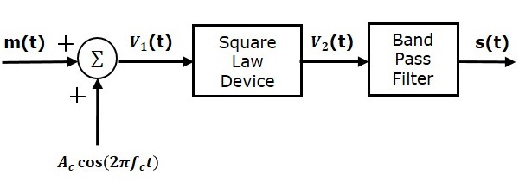
Square Law Modulator
Following is the block diagram of the square law modulator
Non Linear Device

Slide 55
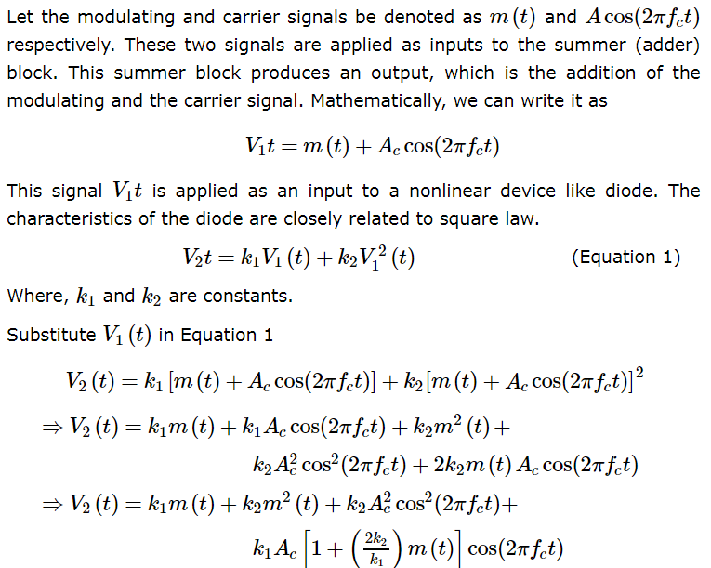

Slide 56
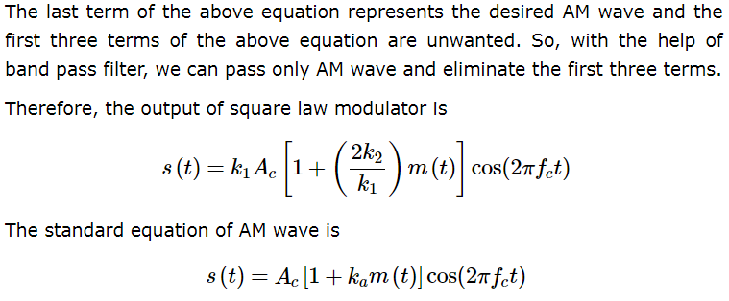

Slide 57
Limitations of Amplitude Modulation
Amplitude Modulation is wasteful of power.
The carrier wave c(t) is completely independent from the information bearing signal m(t). The transmission of carrier wave therefor represents a waste of power, which mean that in Amplitude Modulation only a fraction of the total transmitted power is actually affected by m(t).
Amplitude Modulation is wasteful of Bandwidth.
The upper and lower side bands of AM wave are uniquely related to each other by virtue of their symmetry about the carrier frequency.
Hence, given the magnitude and phase spectra of either sideband, we can uniquely determine the other.

Slide 58
This means that insofar as the transmission of information is concerned, only one sideband is necessary, and the communication channel needs to provide only the same bandwidth as the baseband signal.
In light with of this observation, amplitude modulation is wasteful of bandwidth as it requires a transmission bandwidth equal to twice the message bandwidth
To overcome these limitations, we must make certain modifications: suppressed the carrier and modify the sidebands of the AM Wave.
These modifications naturally result in increased system complexity. In effect we trade system complexity for improved use of communication resources. The basis of this trade off is linear modulation.
In a strict sense, full amplitude modulation does not qualify as linear modulation because of the presence of the carrier wave.

Slide 59
Demodulators
The process of extracting an original message signal from the modulated wave is know as detection or demodulation.
The circuit, which demodulates the modulated wave is known as the demodulator. The following demodulators (detectors) are used for demodulating AM wave
Square Law Demodulator
Envelope Detector
Rectifier Detector
Notes:
.

Slide 60
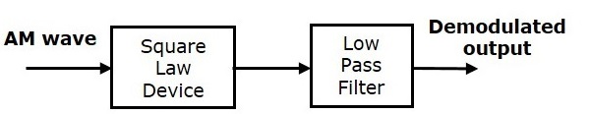
Square Law Demodulator
Square law demodulator is used to demodulate low level AM wave
fm

Slide 61
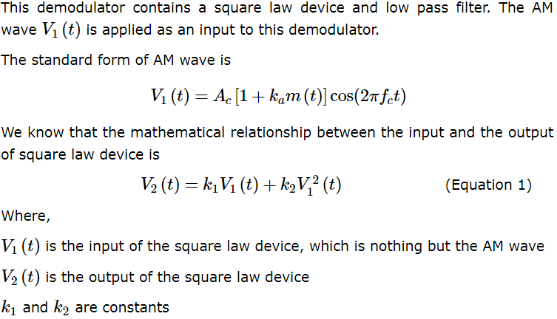

Slide 62
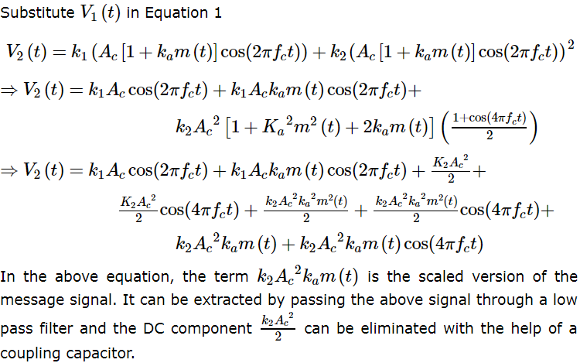

Slide 63
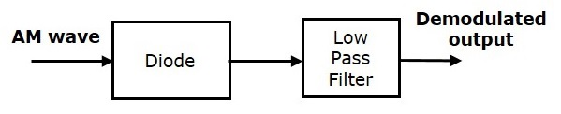
Envelope Detector – Diode Detector
fm
The envelope demodulator is a simple and very efficient device which is suitable for the detection of a narrowband AM signal.
A narrowband AM wave is the one in which the carrier frequency f_{c} is much higher as compared to the bandwidth of the modulating signal .
An envelope demodulator produces an output signal that follows the envelope of the input AM signal exactly . It is used in all the commercial AM radio receivers .

Slide 64
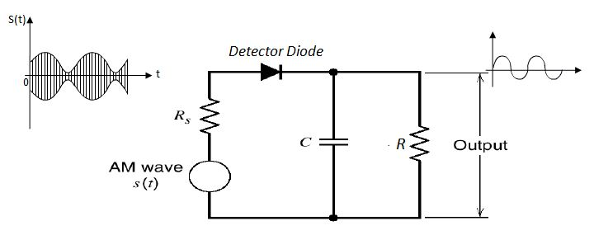
The envelope demodulator consists of a diode and RC filter.
The standard AM wave is applied at the input of the demodulator .
In every positive half cycle of the input, the demodulator diode is forward biased and charge the filter capacitor C connected across the load resistance R to almost the peak value of the input voltage.
As soon as the capacitor charges to the peak value, the diode stop conducting.
Notes:
The Diode will be Reverse biased at the negative half cycles.

Slide 65
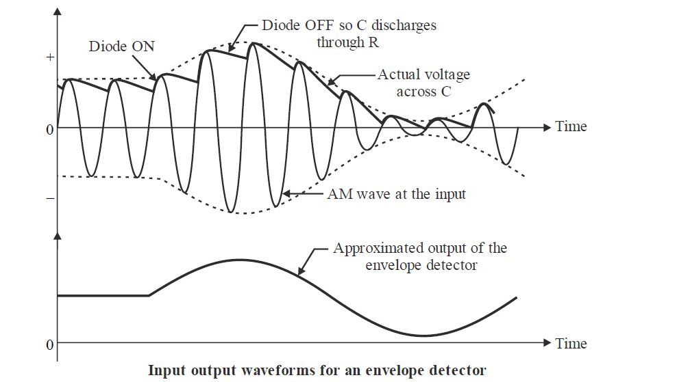
The capacitor will now discharge through R between the positive peaks as shown in figure below. The discharging process continues until the next positive half cycle .
When the input signal becomes greater than the capacitor voltage, the diode conducts again and the process repeats itself
The input-output waveforms for the envelope demodulator is shown in figure below.
Notes:
It shows the charging discharging of the filter capacitor and the approximate output voltage .
It may be observed from these waveforms that the envelope of the AM wave is being recovered successfully .

Slide 66
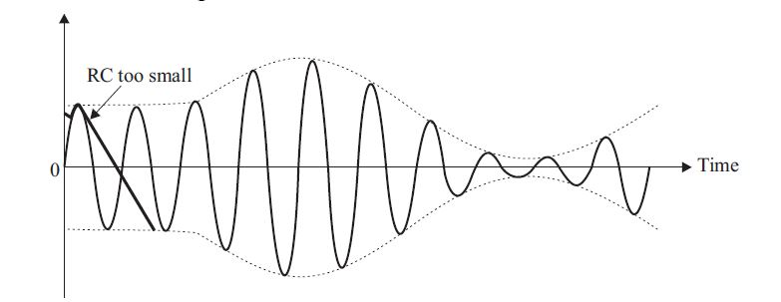
If RC time constant is too small, then the output of the filter falls very rapidly after each peak and will not follow the envelope of the modulated signal closely. This corresponding to the case where bandwidth of LPF is too large.
Notes:
It shows the charging discharging of the filter capacitor and the approximate output voltage .
It may be observed from these waveforms that the envelope of the AM wave is being recovered successfully .

Slide 67
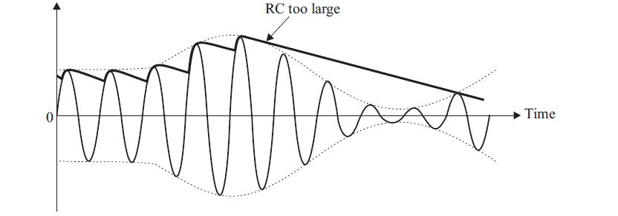
If RC time constant is too large, then the discharge of the capacitor is too slow and again the output will not follow the envelope of the modulated signal. This corresponds to the case where the bandwidth of LPF is too small.
Notes:
It shows the charging discharging of the filter capacitor and the approximate output voltage .
It may be observed from these waveforms that the envelope of the AM wave is being recovered successfully .

Slide 68


Slide 69
In the process of Amplitude Modulation, the modulated wave consists of the carrier wave and two sidebands.
The modulated wave has the information only in the sidebands.
Sideband is nothing but a band of frequencies, containing power, which are the lower and higher frequencies of the carrier frequency.

Slide 70
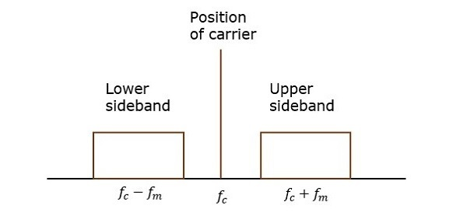
The transmission of a signal, which contains a carrier along with two sidebands can be termed as Double Sideband Full Carrier system or simply DSBFC.

Slide 71
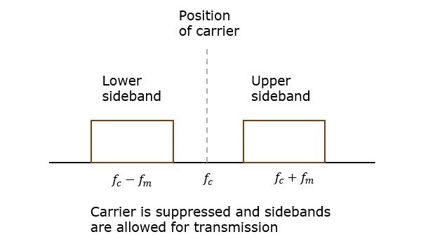
However, such a transmission is inefficient. Because, two-thirds of the power is being wasted in the carrier, which carries no information.
Double Sideband Suppressed Carrier Modulation
If this carrier is suppressed and the saved power is distributed to the two sidebands, then such a process is called as Double Sideband Suppressed Carrier system or simply DSBSC.
Notes:
As

Slide 72
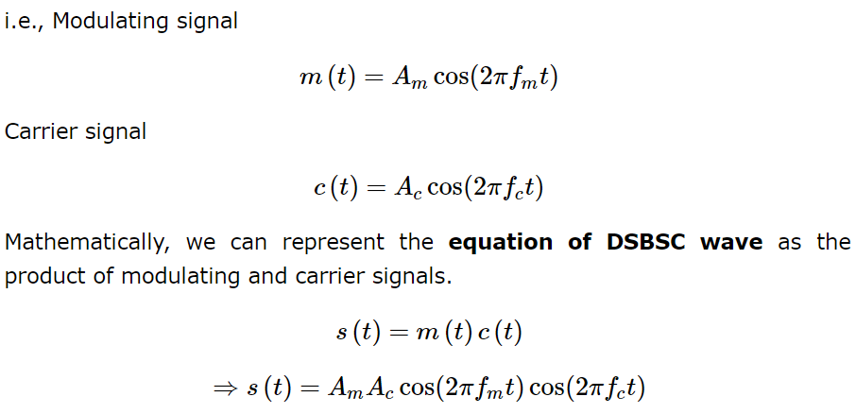
Mathematical Expressions
Let us consider the same mathematical expressions for modulating and carrier signals as we have considered in the earlier

Slide 73
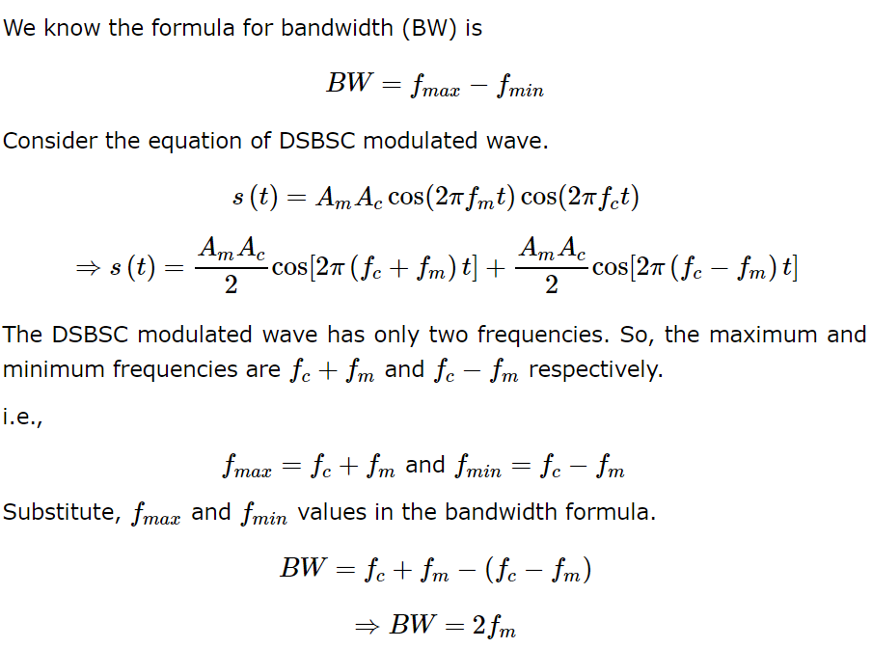
Bandwidth of DSBSC Wave

Slide 74
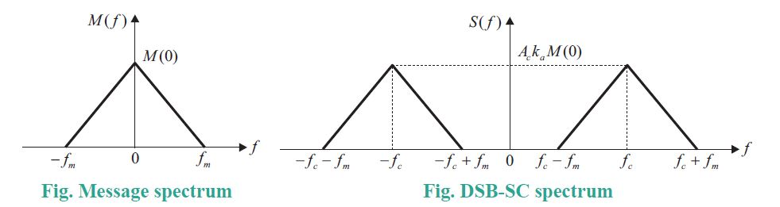

Slide 75
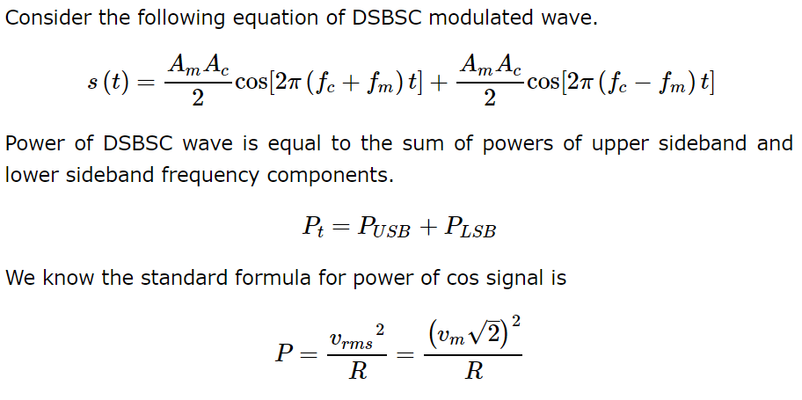
Power Calculations of DSBSC Wave

Slide 76
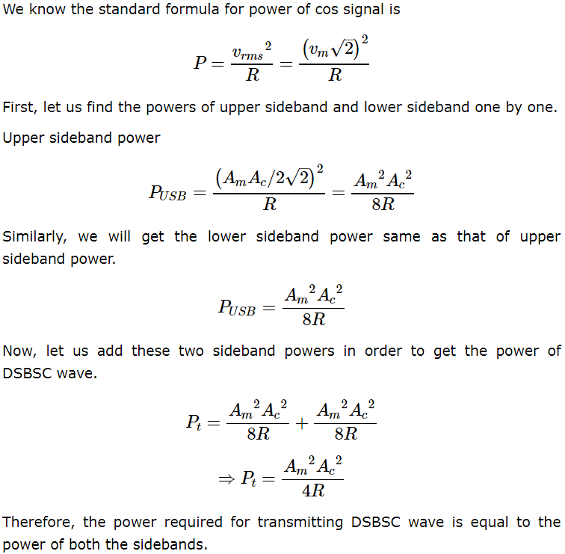

Slide 77
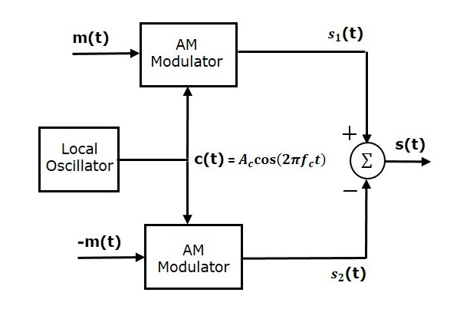
Balanced Modulator
Balanced modulator consists of two identical AM modulators. These two modulators are arranged in a balanced configuration in order to suppress the carrier signal. Hence, it is called as Balanced modulator

Slide 78
The same carrier signal c(t)=Accos(2πfct) is applied as one of the inputs to these two AM modulators.
The modulating signal m(t) is applied as another input to the upper AM modulator. Whereas, the modulating signal m(t) with opposite polarity,[with 180 degree phase shift]−m(t) is applied as another input to the lower AM modulator.
Output of the upper AM modulator is
s1(t)=Ac[1+kam(t)]cos(2πfct)
Output of the lower AM modulator is
s2(t)=Ac[1−kam(t)]cos(2πfct)
We get the DSBSC wave s(t) by subtracting s2(t) from s1(t). The summer block is used to perform this operation. s1(t) with positive sign and s2(t) with negative sign are applied as inputs to summer block.

Slide 79
Thus, the summer block produces an output s(t) which is the difference of s1(t) and s2(t).
s(t) = s1(t) - s2(t)
⇒s(t)=Ac[1+kam(t)]cos(2πfct)−Ac[1−kam(t)]cos(2πfct)
⇒s(t)=Accos(2πfct)+Ackam(t)cos(2πfct)−Accos(2πfct)+
Ackam(t)cos(2πfct)
⇒s(t)=2Ackam(t)cos(2πfct)
We know the standard equation of DSBSC wave is
s(t)=c(t).m(t)=Acm(t)cos(2πfct)
By comparing the output of summer block with the standard equation of DSBSC wave, we will get the scaling factor as 2ka

Slide 80
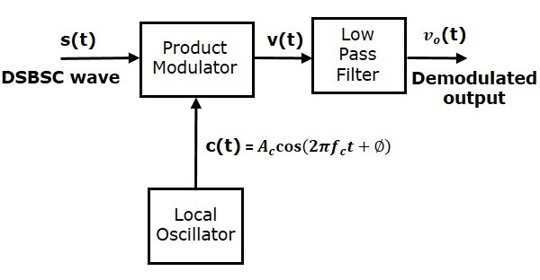
Coherent Detector
Here, the same carrier signal (which is used for generating DSBSC signal) is used to detect the message signal.
Hence, this process of detection is called as coherent or synchronous detection. Following is the block diagram of the coherent detector

Slide 81
In this process, the message signal can be extracted from DSBSC wave by multiplying it with a carrier, having the same frequency and the phase of the carrier used in DSBSC modulation.
The resulting signal is then passed through a Low Pass Filter. Output of this filter is the desired message signal.
Let the DSBSC wave be s(t)=Accos(2πfct)m(t)
The output of the local oscillator is c(t)=Accos(2πfct+ϕ)
Where, ϕ is the phase difference between the local oscillator signal and the carrier signal, which is used for DSBSC modulation.
From the figure, we can write the output of product modulator as
v(t)=s(t)c(t)

Slide 82
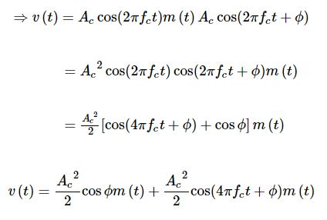
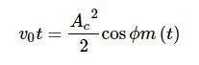
Substitute, s(t) and c(t) values in the above equation.
In the above equation, the first term is the scaled version of the message signal. It can be extracted by passing the above signal through a low pass filter.
Therefore, the output of low pass filter is

Slide 83
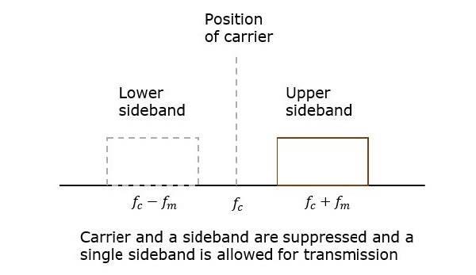
SSBSC Modulation
The DSBSC modulated signal has two sidebands. Since, the two sidebands carry the same information, there is no need to transmit both sidebands. We can eliminate one sideband.
The process of suppressing one of the sidebands along with the carrier and transmitting a single sideband is called as Single Sideband Suppressed Carrier system or simply SSBSC.

Slide 84
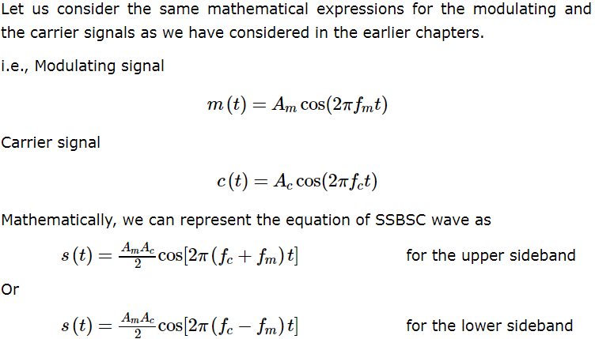


Mathematical Expressions

Slide 85
Bandwidth of SSBSC Wave
We know that the DSBSC modulated wave contains two sidebands and its bandwidth is 2fm
Since the SSBSC modulated wave contains only one sideband, its bandwidth is half of the bandwidth of DSBSC modulated wave.
Therefore, the bandwidth of SSBSC modulated wave is fm and it is equal to the frequency of the modulating signal.

Slide 86
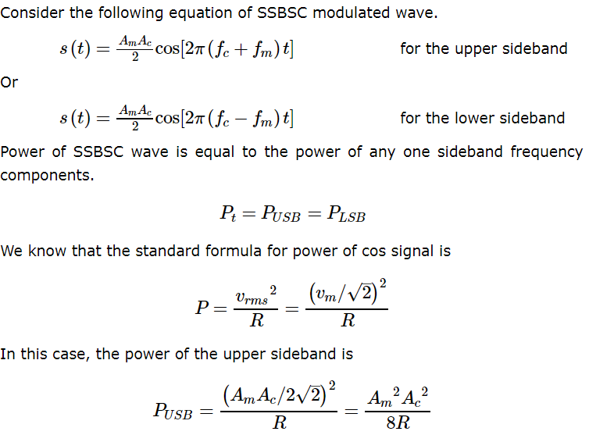
Power Calculations of SSBSC Wave

Slide 87
Advantages
Bandwidth or spectrum space occupied is lesser than AM and DSBSC waves.
Transmission of more number of signals is allowed.
Power is saved.
High power signal can be transmitted.
Less amount of noise is present.
Signal fading is less likely to occur.
Disadvantages
The generation and detection of SSBSC wave is a complex process.
The quality of the signal gets affected unless the SSB transmitter and receiver have an excellent frequency stability

Slide 88
Applications
For power saving requirements and low bandwidth requirements.
In land, air, and maritime mobile communications.
In point-to-point communications.
In radio communications.
In television, telemetry, and radar communications.
In military communications, such as amateur radio, etc.

Slide 89
SSBSC Modulators
SSBSC waves can be generated using following two methods.
Frequency discrimination method
Phase shift method

Slide 90
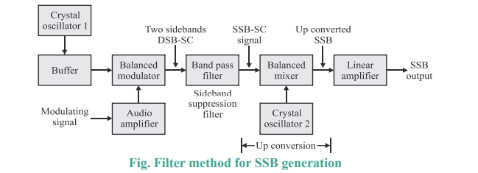
Filter method (Frequency discrimination method)
In filter method, a DSB-SC signal is generated first using a balanced modulator or product modulator and then one sideband either upper sideband or lower sideband is removed using a sideband filter. Accordingly, the output is either LSB SSB-SC or USB SSB-SC signal.

Slide 91
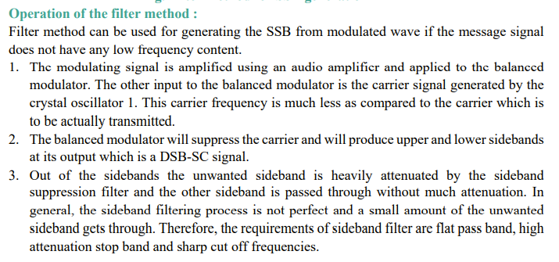

Slide 92


Slide 93


Slide 94



Slide 95

Phase Shift Method
t is the most powerful method for SSB generation. The block diagram for the phase shift method of SSB generation is shown. This system uses two balanced modulators or product modulators 1 and 2 and two - 90 degree phase shifting networks

Slide 96


Slide 97


Slide 99


Slide 100

Coherent Detector
Here, the same carrier signal (which is used for generating SSBSC wave) is used to detect the message signal. Hence, this process of detection is called as coherent or synchronous detection.

Slide 101


Slide 102


Slide 103
VSBSC Modulation
SSBSC modulated signal has only one sideband frequency. Theoretically, we can get one sideband frequency component completely by using an ideal band pass filter. However, practically we may not get the entire sideband frequency component. Due to this, some information gets lost.
To avoid this loss, a technique is chosen, which is a compromise between DSBSC and SSBSC. This technique is known as Vestigial Side Band Suppressed Carrier (VSBSC) technique. The word “vestige” means “a part” from which, the name is derived.

Slide 104

VSBSC Modulation is the process, where a part of the signal called as vestige is modulated along with one sideband.
Along with the upper sideband, a part of the lower sideband is also being transmitted in this technique. Similarly, we can transmit the lower sideband along with a part of the upper sideband. A guard band of very small width is laid on either side of VSB in order to avoid the interferences.

Slide 105

Bandwidth of VSBSC Modulation
Advantages
Highly efficient.
Reduction in bandwidth when compared to AM and DSBSC waves.
Filter design is easy, since high accuracy is not needed.
The transmission of low frequency components is possible, without any difficulty.
Disadvantages
Bandwidth is more when compared to SSBSC wave.
Demodulation is complex.

Slide 106

Generation of VSBSC
To generate a VSB signal, a DSB-SC signal is generated first and is then passed through a sideband filter as shown in below figure. This filter will pass the wanted sideband as it is along with a part of unwanted sideband
The VSB signal obtained at the output of filter is applied to a chain of linear amplifiers and raised in power by the power amplifiers. The amplified signal is then applied to the transmitting antenna for transmission of signal

Slide 107


Slide 108

Modulation of VSBSC
VSB signal can be generated by passing a DSB-SC signal through an appropriate VSB filter having transfer function H f ( ).

Slide 109

DeModulation of VSBSC

Slide 110


Slide 111


Slide 112

AM Receiver
The most common AM receivers in use today are the super heterodyne type
They consist of:
Antenna
RF amplifier
Local Oscillator and Mixer
IF Section
Detector and Amplifier + Speaker
Red parts are those that handle the incoming Radio Frequency (RF) signal
Green are parts that operate at the intermediate frequency (IF)
Blue parts operate at the modulation (audio) frequency
The dotted line indicates that the local oscillator and RF filter must be tuned in tandem

Slide 113
RF TUNING & AMPLIFICATION
This RF stage within the overall block diagram for the receiver provides initial tuning to remove the image signal.
It also provides some amplification.
If noise performance for the receiver is important, then this stage will be designed for optimum noise performance.
This RF amplifier circuit block, will also increase the signal level so that the noise introduced by later stages is at a lower level in comparison to the wanted signal.

Slide 114
LOCAL OSCILLATOR
The local oscillator circuit block can take a variety of forms.
Early receivers used free running local oscillators.
Today most receivers use frequency synthesizers.
These provide much greater levels of stability and enable frequencies to be programmed in a variety of ways.

Slide 115


MIXER
Both the local oscillator and incoming signal enter this block within the super heterodyne receiver.
The wanted signal is converted to the intermediate frequency.
IF AMPLIFIER & FILTER
This super heterodyne receiver block provides the majority of gain and selectivity.
High performance filters like crystal filters may be used, although LC or ceramic filters may be used within domestic radios.

Slide 116
Demodulator
The super heterodyne receiver block diagram only shows one demodulator, but in reality radios may have one or more demodulators dependent upon the type of signals being received
Automatic Gain Control
An automatic gain control is incorporated into most super heterodyne radios.
Its function is to reduce the gain for strong signals so that the audio level is maintained for amplitude sensitive forms of modulation.
Also to prevent overloading.

Slide 117
AUDIO AMPLIFIER
Once demodulated, the recovered audio is applied to an audio amplifier block to be amplified to the required level for loudspeakers or headphones.
Alternatively, the recovered modulation may be used for other applications whereupon it is processed in the required way by a specific circuit block.

Slide 118
Working of the Receiver
Signals enter the receiver from the antenna and are applied to the RF amplifier where they are tuned to remove the image signal and also reduce the general level of unwanted signals on other frequencies that are not required.
The signals are then applied to the mixer along with the local oscillator where the wanted signal is converted down to the intermediate frequency.
Here significant levels of amplification are applied and the signals are filtered.
This filtering selects signals on one channel against those on the next.

Slide 119
Working of the Receiver
The advantage of the IF filter as opposed to RF filtering is that the filter can be designed for a fixed frequency. This allows for much better tuning.
Variable filters are never able to provide the same level of selectivity that can be provided by fixed frequency ones.
Once filtered the next block in the super heterodyne receiver is the demodulator.
This could be for amplitude modulation, single sideband, frequency modulation, or indeed any form of modulation.
It is also possible to switch different demodulators in according to the mode being received.
The final element in the super heterodyne receiver block diagram is shown as an audio amplifier, although this could be any form of circuit block that is used to process or amplified the demodulated signal.

